Slide 1
Random forest for classification
What is Random forest?
Random forest is a supervised learning algorithm. It is use for both classification and regression problem. The "forest" it builds, is an ensemble of decision trees, usually trained with the “bagging” method. The general idea of the bagging method is that a combination of learning models increases the overall result.
Note: Random forest create sample dataset using row sampling with replacement and feature sampling with replacement.

Slide 2
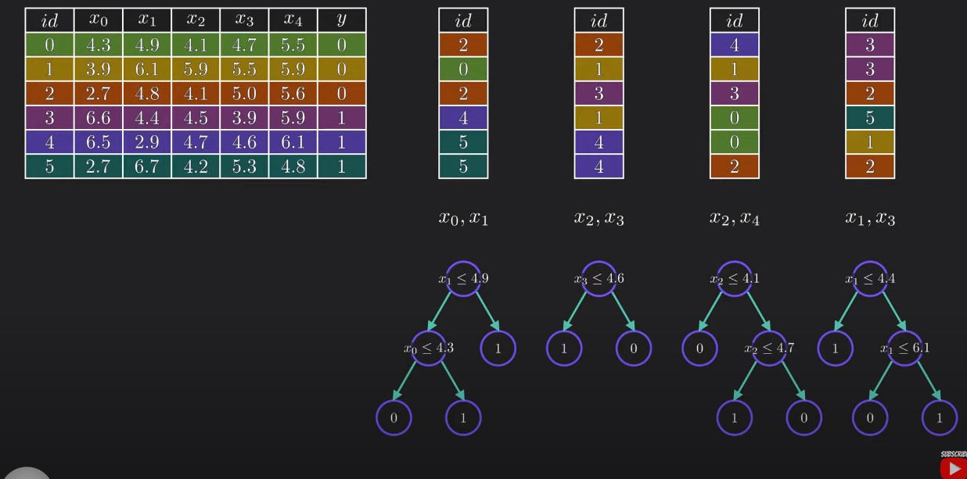
Random forest for classification

Slide 3
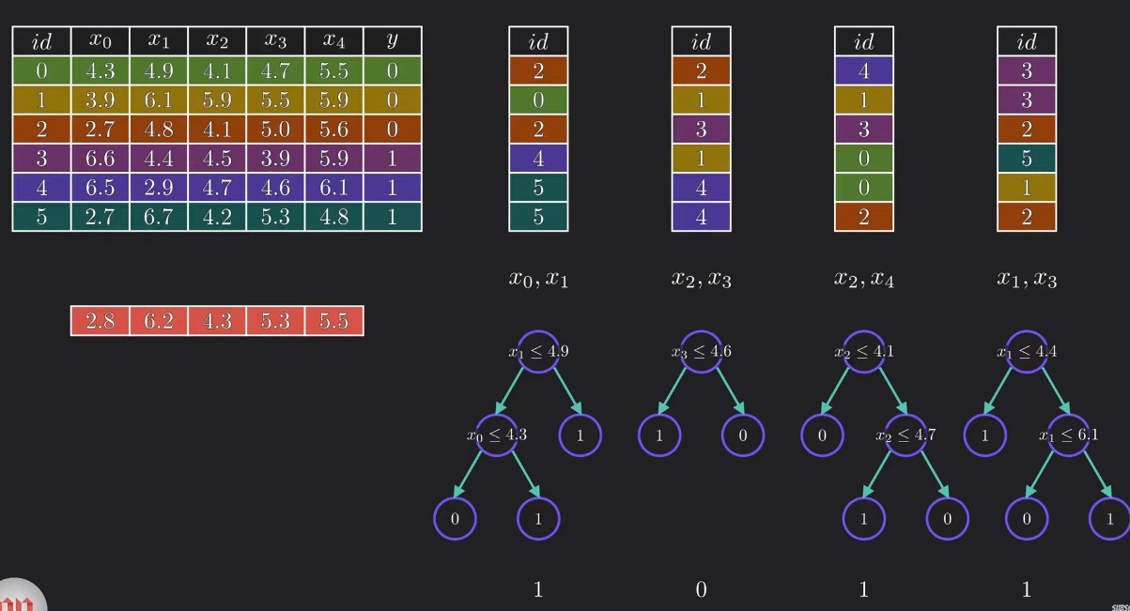
Random forest for classification

Slide 4
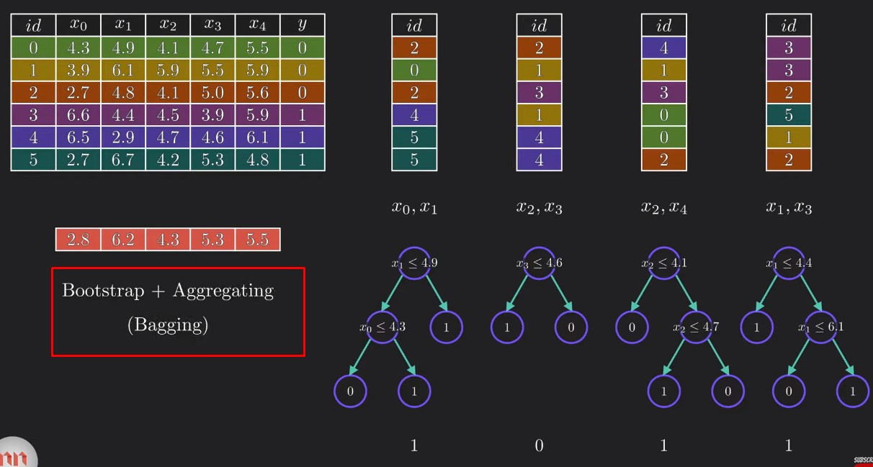
Random forest for classification

Slide 5
Random forest for regression
Random forest regression work with same procedure as like classification. We know in regression problem our target variable most of the time contain continuous value. In random forest regression what is do take the all continuous value that’s come from the multiple decision that are created by random forest. From all the continuous values find the mean value or median value based on the data distributions.

